Slide 1
Food recommendation
17IT036 - Dipen Joshi

Slide 2
What’s problem?
People make decisions related to food every day. They all think about what to eat, where to eat, how much nutritional value this food has, can this make me lose weight, can this food make me healthy and other questions.
Now due to corona virus days , we cannot trust any food stalls and restaurants for the corona virus.
If we wanted to eat something outside food is difficult for us.
Then I have find one solution.

Slide 3
solution
The solution is use the food recommendation system.
Food recommendation system is helpful for recommondate nice and healthy food stall and restaurant.
It is easily detected by its rating of good food stall and restaurant in any place.

Slide 4
Scops
IT is targeted towards a local audience, for now, and as of present it can only be used as a web application that recommends food based in their nutritional value.
The application can help people who like to eat preferable food or recommondated food.

Slide 5
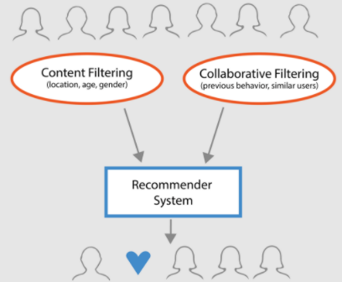
Contant
AS a figure we use the content rating and collaborative rating the recommender the food or stall in the system
A user profile is built with these attributes. Items are ranked by how closely they match the user attribute profile, and the best matches are recommended.

Slide 6
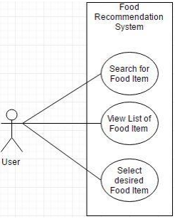
How to use
First of we make one system ,they search your location or city.
Then you select or search the good food stall by it’s rating.
They view the list of food items
Then you see which food is healthy and preferable.
And you go to the stall and enjoy our recommendational choice

Slide 7
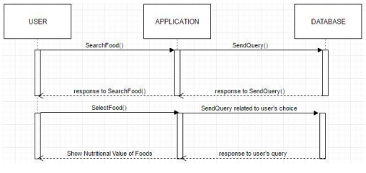
Sequence diagram
As in Figure , the user inputs a food item query in the application.
The list of food with the food item query with the main ingredient is shown.

Slide 8
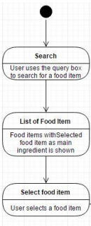
State diagram
The Figure explain the states of the application. When the user opens the application, they can make a search for the food item in near by you.
Then they are directed to a page where there is a list of food items where the searched ingredient is the main ingredient. They select a food item.

Slide 9
Tools used
The application is based on Flask framework.
It uses python programming language.

Slide 10
Conclusion
The project Food Recommendation System was successfully completed by using Content Based Filtering Algorithm. The data set were collected by web scraping which was preprocessed on the basis attributes. The data were then used to model the system.

Slide 11
Thank you

